Slide 1





Going Viral Technology Demo

Slide 2


Hello
We are Going Viral!

Slide 3



Our Idea
Machine learning to track the distribution of Covid-19 throughout a population

Slide 4
Machine learning
Is capable of detecting coughs
Able to distinguish covid and non covid coughs
Identifies the number of people that have passed by
Can possibly be adapted to covid variants and other diseases

Slide 5








Blender
These are our concept images for our innovation

Slide 6
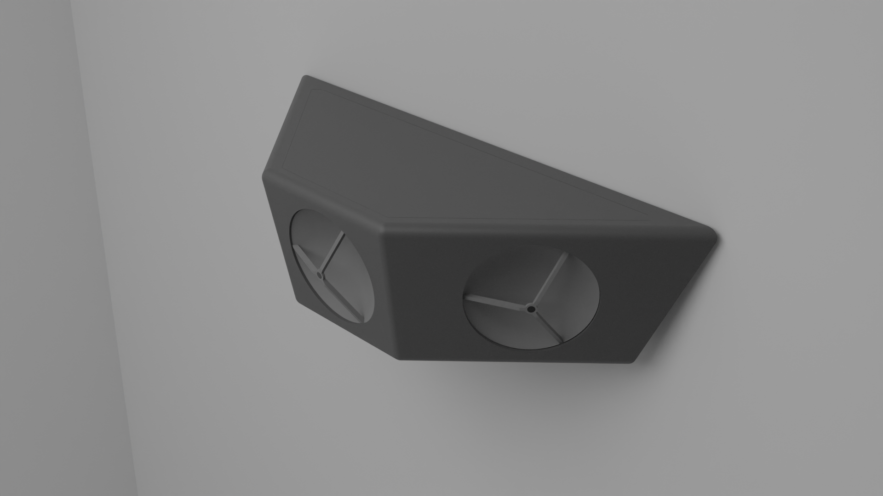



Slide 7
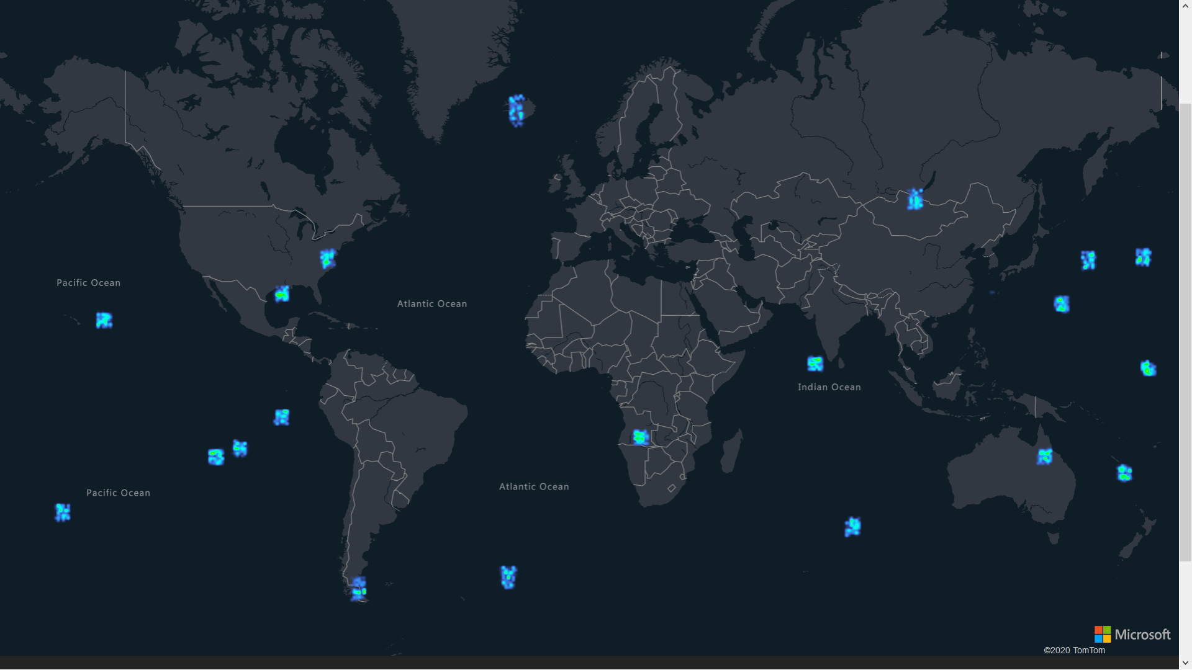
Web app
We have a website to spread the information we gather out to the communities
Website
The website provides a weather map like view of the spread of the disease

Slide 8
Cyber Security
Data Collection:
The only data being stored is the number of coughs, number of cases, and location data.
Overall threat:
There is less security risk than a video surveillance system. No video or recording is sent outside of the camera. Only numbers

